Slide 1

Thrust Vectoring: What is it and how does it work?
By Arthur Jacobs

Slide 2
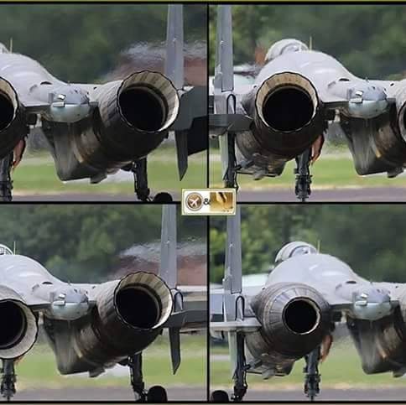
What is Thrust Vectoring?
Thrust vectoring itself is a flight control technique where the direction of an engines exhaust is purposefully deflected to generate extra control and lift (Angle of Attack) so an aircraft can turn tighter.
This can also include V/STOL (Vertical short takeoff and landing), which changes the operational deployment of capabilities of aircraft, such as those which can take off from aircraft carriers such as the harrier and F35 B.

Slide 3
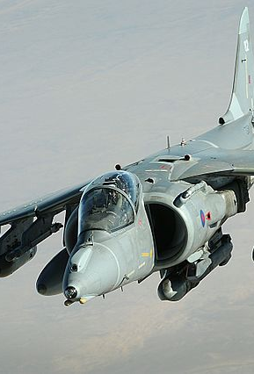
The Harrier Jump-Jet
The Hawker-Siddeley Harrier was the first ever operational usage of vectored thrust. It was mainly used in V/STOL scenarios, but pilots in the falklands war also were reported to direct its four mechanically swiveling nozzles in combat, to give them a maneuverable edge against the Argentinian pilots they faced.
It was developed in the late 1950s to the ealy 1960s, with its introduction to service in the RAF in 1969. It was in service for over 40 years with the RAF, and was exported all over the world, from America to Spain.

Slide 4
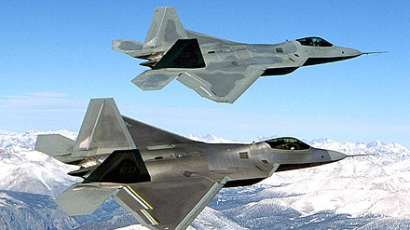
The F-22
The F-22 is arguably the most successful employment of thrust vectoring, making it super-maneuverable at both high and low speeds.
It utilizes the raw power of two Pratt and Whitney F-119 engines, generating a combined 72000lbf of thrust in full afterburner and 52000lbf at military power, meaning its thrust to weight ratio is well over 1:1, allowing for it to super cruise (fly at supersonic speeds with no afterburner) at around mach 1.5.
This vast power combined with its thrust vectoring capabilities are just some of the reasons why it is considered the most lethal aircraft ever built.

Slide 5
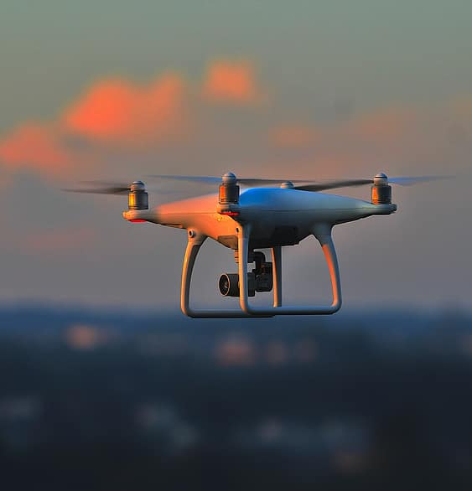
Distributed electric propulsion
Distributed electric propulsion (DEP) is a method of powering aircraft with multiple smaller electrically driven propellers are positioned around an airframe instead of one or two conventional engines. DEP allows for: greater lift at low speeds, smaller wings (which reduces drag) and thrust vectoring through the change in RPM of individual propellers.
They are widely considered to be the future of propulsion in certain applications, as they can be paired with hydrogen fuel cells to make completely carbon-free aircraft, as well as being significantly quieter.

